Slide 1

“I've been thinking about laws on Mars. There's an international treaty saying that no country can lay claim to anything that's not on Earth. By another treaty if you're not in any country's territory, maritime law applies. So Mars is international waters. Now, NASA is an American non-military organization, it owns the Hab. But the second I walk outside I'm in international waters. So Here's the cool part. I'm about to leave for the Schiaparelli Crater where I'm going to commandeer the Ares IV lander. Nobody explicitly gave me permission to do this, and they can't until I'm on board the Ares IV. So I'm going to be taking a craft over in international waters without permission, which by definition... makes me a pirate. Mark Watney: Space Pirate.”

Slide 2
Lecture Two
The Adversarial Mindset

Slide 3

Target Selection
Targeted based on opportunity
Known ability to access (vulnerability, supply chain interdiction, insider threat, etc.)
Targeted based on who owns SV
Operated by a government or company the attacker wants to impact
Targeted specifically
Space System targeted because of exactly what it is
Targeted based on what SV does
Going after any space system with a certain mission or missions
Regardless of selection method, the mission of the space system will drive kill-chain closure
Notes:
The cyber attacks hackers could deploy to degrade disable or destroy a satellite system

Slide 4
Targeting Space Systems
Target Selection
What is the thing that is being attacked, how was it chosen
Desired effect
What is the thing the attack looks to achieve
Notes:
The cyber attacks hackers could deploy to degrade disable or destroy a satellite system

Slide 5
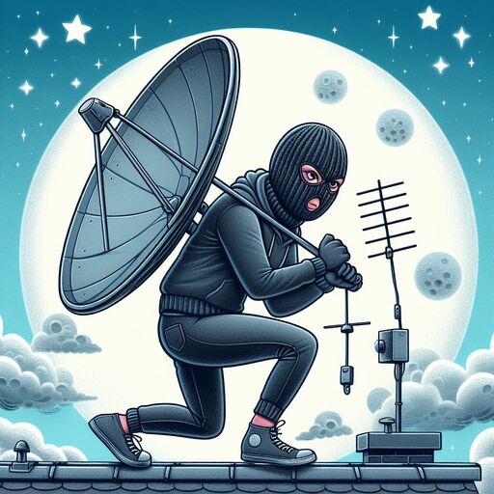
Motivation
Collection
Redirection
Subversion
Theft
Disable

Slide 6

Target Selection
Targeted based on opportunity
Known ability to access (vulnerability, supply chain interdiction, insider threat, etc.)
Targeted based on who owns SV
Operated by a government or company the attacker wants to impact
Targeted specifically
Space System targeted because of exactly what it is
Targeted based on what SV does
Going after any space system with a certain mission or missions
Notes:
The cyber attacks hackers could deploy to degrade disable or destroy a satellite system

Slide 7
Space Vehicle Types
LEO
MEO
HEO ~Geo-stationary
Non-Earth Orbital
Non-Earth
Deep Space
Notes:
Cover the various ways a hacker could compromise the various mission types carried out by space vehicles
Sensing Missions
Imaging
Exploit payload control computer to do things like, put the lens out of focus so pictures it takes are useless
Monitoring
Remove certain triggers so that monitoring sensing payloads never record. Like if a payload waited for nuclear like events and then recorded radiation levels or heat levels, make it never think there was an event, or that events are happening every second to deny the payload function to the asset operator
Emitting Missions
Positioning
Attacking the data provided from GPS sensors before it is broadcast to the ground, so receivers get bad positioning information from the space vehicle and triangulation is no longer reliable
Jamming
Alter the frequency that is being jammed or turn off jamming altogether yet have the space vehicle report to the ground that everything is running fine. Hard to tell from the ground if your satellite is jamming something else in space outside of it telling you it is.
Communications Missions
Broadcast
Attacking broadcast payloads like satellite radio or DirecTV by altering what is being sent down to the broadcast footprint
Pipe providers
Mirror pipes on communications satellite, close them down or make them extremely poor to degrade the use of that communications pipe
Human Life Preservation on crewed space vehicles
Insert any scary scenario where things that keep people alive on a space vehicle are attacked by a hacker from the ground. There is a lot of built in redundancy to these types of systems but not a ton of work on keeping backups and other things segregated with the intent of stopping a hacker from being able to turn off environmental controls and turning off safeguards

Slide 8
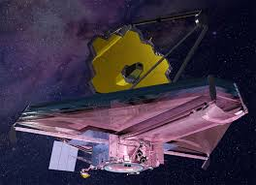
Targeting via Mission Type: Sensing
Sensing missions
Radio Frequency (RF)
Optical
Infrared (IR)
Radiation
Notes:
Cover the various ways a hacker could compromise the various mission types carried out by space vehicles
Sensing Missions
Imaging
Exploit payload control computer to do things like, put the lens out of focus so pictures it takes are useless
Monitoring
Remove certain triggers so that monitoring sensing payloads never record. Like if a payload waited for nuclear like events and then recorded radiation levels or heat levels, make it never think there was an event, or that events are happening every second to deny the payload function to the asset operator
Emitting Missions
Positioning
Attacking the data provided from GPS sensors before it is broadcast to the ground, so receivers get bad positioning information from the space vehicle and triangulation is no longer reliable
Jamming
Alter the frequency that is being jammed or turn off jamming altogether yet have the space vehicle report to the ground that everything is running fine. Hard to tell from the ground if your satellite is jamming something else in space outside of it telling you it is.
Communications Missions
Broadcast
Attacking broadcast payloads like satellite radio or DirecTV by altering what is being sent down to the broadcast footprint
Pipe providers
Mirror pipes on communications satellite, close them down or make them extremely poor to degrade the use of that communications pipe
Human Life Preservation on crewed space vehicles
Insert any scary scenario where things that keep people alive on a space vehicle are attacked by a hacker from the ground. There is a lot of built in redundancy to these types of systems but not a ton of work on keeping backups and other things segregated with the intent of stopping a hacker from being able to turn off environmental controls and turning off safeguards

Slide 9
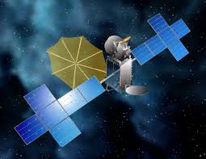
Targeting via Mission Type: Emitting
Emitting missions
Interference
Injection
Laser
Navigation
Notes:
Cover the various ways a hacker could compromise the various mission types carried out by space vehicles
Sensing Missions
Imaging
Exploit payload control computer to do things like, put the lens out of focus so pictures it takes are useless
Monitoring
Remove certain triggers so that monitoring sensing payloads never record. Like if a payload waited for nuclear like events and then recorded radiation levels or heat levels, make it never think there was an event, or that events are happening every second to deny the payload function to the asset operator
Emitting Missions
Positioning
Attacking the data provided from GPS sensors before it is broadcast to the ground, so receivers get bad positioning information from the space vehicle and triangulation is no longer reliable
Jamming
Alter the frequency that is being jammed or turn off jamming altogether yet have the space vehicle report to the ground that everything is running fine. Hard to tell from the ground if your satellite is jamming something else in space outside of it telling you it is.
Communications Missions
Broadcast
Attacking broadcast payloads like satellite radio or DirecTV by altering what is being sent down to the broadcast footprint
Pipe providers
Mirror pipes on communications satellite, close them down or make them extremely poor to degrade the use of that communications pipe
Human Life Preservation on crewed space vehicles
Insert any scary scenario where things that keep people alive on a space vehicle are attacked by a hacker from the ground. There is a lot of built in redundancy to these types of systems but not a ton of work on keeping backups and other things segregated with the intent of stopping a hacker from being able to turn off environmental controls and turning off safeguards

Slide 10
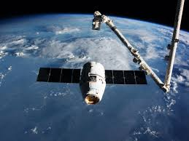
Targeting via Mission Type
Transit
Cargo
Passenger
Communications
Weapon
Notes:
Cover the various ways a hacker could compromise the various mission types carried out by space vehicles
Sensing Missions
Imaging
Exploit payload control computer to do things like, put the lens out of focus so pictures it takes are useless
Monitoring
Remove certain triggers so that monitoring sensing payloads never record. Like if a payload waited for nuclear like events and then recorded radiation levels or heat levels, make it never think there was an event, or that events are happening every second to deny the payload function to the asset operator
Emitting Missions
Positioning
Attacking the data provided from GPS sensors before it is broadcast to the ground, so receivers get bad positioning information from the space vehicle and triangulation is no longer reliable
Jamming
Alter the frequency that is being jammed or turn off jamming altogether yet have the space vehicle report to the ground that everything is running fine. Hard to tell from the ground if your satellite is jamming something else in space outside of it telling you it is.
Communications Missions
Broadcast
Attacking broadcast payloads like satellite radio or DirecTV by altering what is being sent down to the broadcast footprint
Pipe providers
Mirror pipes on communications satellite, close them down or make them extremely poor to degrade the use of that communications pipe
Human Life Preservation on crewed space vehicles
Insert any scary scenario where things that keep people alive on a space vehicle are attacked by a hacker from the ground. There is a lot of built in redundancy to these types of systems but not a ton of work on keeping backups and other things segregated with the intent of stopping a hacker from being able to turn off environmental controls and turning off safeguards

Slide 11

Targeted for Potential
Software definition expands targetability
Repurposing alters adversary cost benefit calculus
Target because of what you could be
A Sensor becomes a jammer
A Comms payload becomes a listener
A transport (or anything big enough) becomes a weapon
Notes:
Cover the various ways a hacker could compromise the various mission types carried out by space vehicles
Sensing Missions
Imaging
Exploit payload control computer to do things like, put the lens out of focus so pictures it takes are useless
Monitoring
Remove certain triggers so that monitoring sensing payloads never record. Like if a payload waited for nuclear like events and then recorded radiation levels or heat levels, make it never think there was an event, or that events are happening every second to deny the payload function to the asset operator
Emitting Missions
Positioning
Attacking the data provided from GPS sensors before it is broadcast to the ground, so receivers get bad positioning information from the space vehicle and triangulation is no longer reliable
Jamming
Alter the frequency that is being jammed or turn off jamming altogether yet have the space vehicle report to the ground that everything is running fine. Hard to tell from the ground if your satellite is jamming something else in space outside of it telling you it is.
Communications Missions
Broadcast
Attacking broadcast payloads like satellite radio or DirecTV by altering what is being sent down to the broadcast footprint
Pipe providers
Mirror pipes on communications satellite, close them down or make them extremely poor to degrade the use of that communications pipe
Human Life Preservation on crewed space vehicles
Insert any scary scenario where things that keep people alive on a space vehicle are attacked by a hacker from the ground. There is a lot of built in redundancy to these types of systems but not a ton of work on keeping backups and other things segregated with the intent of stopping a hacker from being able to turn off environmental controls and turning off safeguards

Slide 12


Vectors
Pre-Operational
Operational
Operational
Notes:
Ways hackers could get their attack effects to delivered to the satellite system

Slide 13
Pre-Operational Vector
Design
Development
Testing
Transportation
Storage
Launch
Notes:
Mars rescheduling 26 months due to sling shot stuff

Slide 14
Operational Vector
Ground / space link (both directions)
Space links
Inter-vehicle
SV to SV
Analysis & Dissemination
Consumers / Customers

Slide 15
Bus to Payload

Slide 16
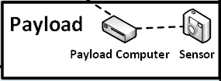
Payload to Payload

Slide 17
Payload to Bus

Slide 18
Space to Ground

Slide 19
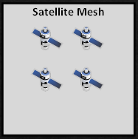
Space to Space

Slide 20
Cross-Constellation

Slide 21
Exploitation
Delineation between SV systems and mission systems is important in any non-integrated SV due to ownership of risks, protections, ground segments etc.
If ransom is goal, may take whichever you can access, be it hosted payload or bus
If collection is goal, may have to be payload side
If disabling the SV is goal, may have to be bus side

Slide 22
Subsystems to Exploit
Bus and Payload Subsystems
Tasking (receiving, executing, storing)
PNT knowledge
Communications
Protections (resource limiters, watchdogs, etc.)
Bus specific subsystems
Power (generation, distribution, storage)
Attitude

Slide 23
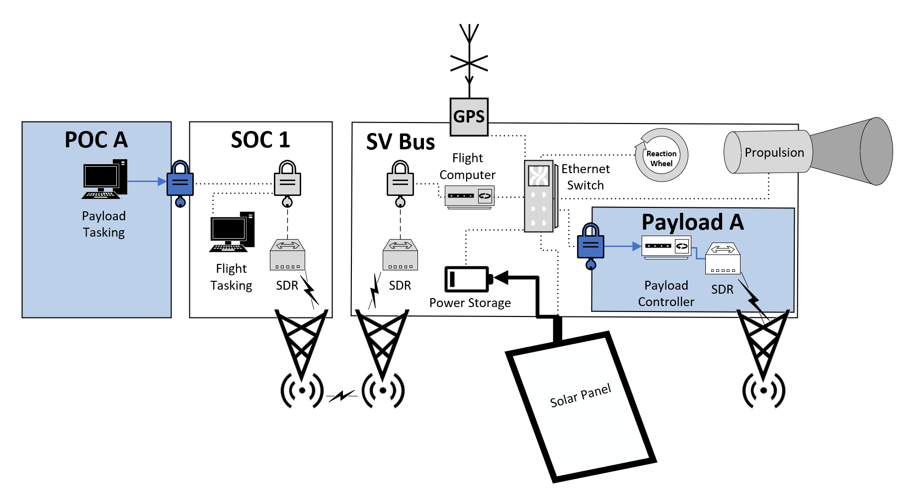
Subsystems to Exploit Illustrated

Slide 24
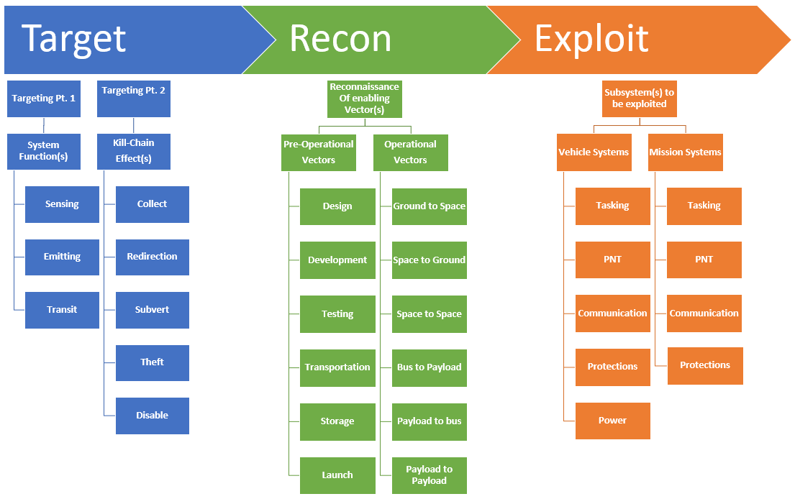

Slide 25

Tradecraft Considerations

Slide 26
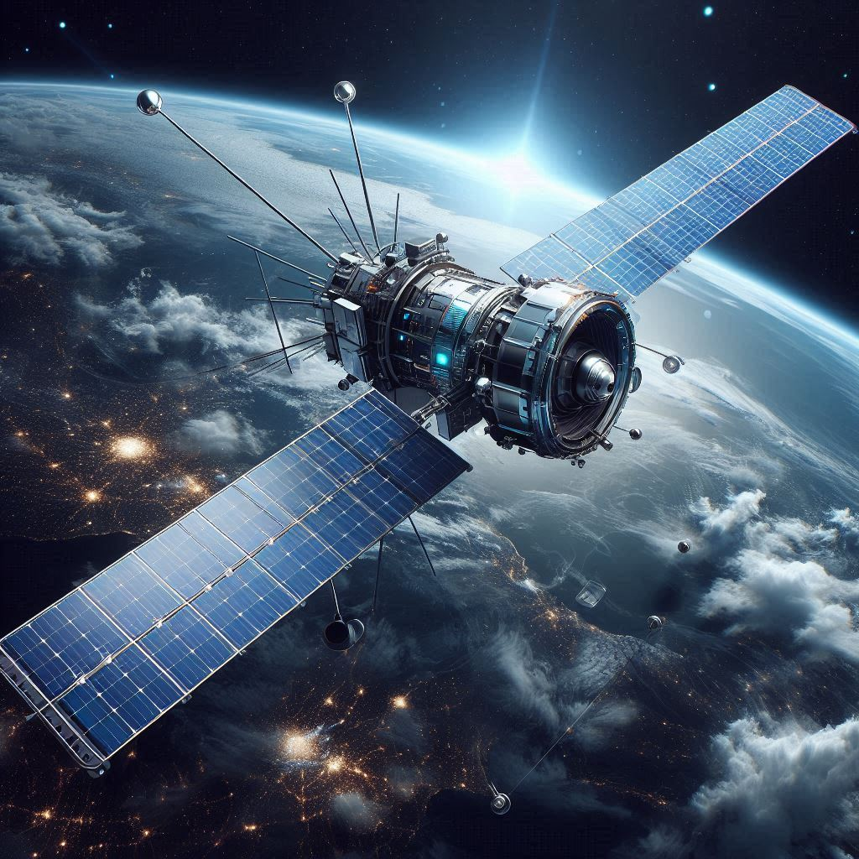
LEO Constraints
Persistent vs non-persistent communications
Orbital implications
Constellations, meshes and formation flying

Slide 27

Asynchronous Satellite Operations
Tasking ahead
Prioritization of commands
Station keeping vs power generation vs mission etc.
Impacts of automated SV activity
Watchdogs and resource limiters
Predicting availability and usability

Slide 28
Asynchronous Cyber Operations
Operating in the blind
Working without guaranteed communications
Troubleshooting challenges
Dynamic operations
Tradecraft implications

Slide 29

Pivoting
Ground to Space
Inter-Bus
Bus to Payload
Payload to Payload
Payload to Bus
Space to Space
Space to ground

Slide 30

SV Code Execution
Living off the land
Tasking updates
Abusing watchdogs like scheduled tasks?
Registering your own apps
IOCs
Getting caught or killed by redundancy mechanisms

Slide 31

Realistic Compromise Scenario
Notes:
Walk through how a single space vehicle and ground station could be compromised with existing exploits given common software and hardware choices
Scenario: A nation state wants to test out its ability to compromise a space system and decides on an academic space program at a foreign university to practice on

Slide 32
Notes:
They social engineer their way into sending the student an infected PDF. They pretend to be a renown professor in a related field who is interested in their work and wants the student’s input on a paper they are writing. The infected pdf allows the attacker to install an implant on the student’s personal laptop

Slide 33
Notes:
With access to the laptop the attacker uses something like the tool DualToy which allows the uploading of malicious files to the student’s phone when it is charging via USB cable to the laptop. This is used to implant the cell phone

Slide 34
Notes:
With the access on the phone the attacker tasks a bunch of dir’s and permission checks and other things from the phone implant whenever it is plugged into another machine. The attacker notices the phone is also being charged via USB at the lab the student works in. The machine it sees is a Linux host running windows VM’s that are the ground station. The attacker uses the implanted phone to find a world writeable script being executed as root and appends malware to the script so that the next time it fires, the attacker now has an implant on the air gapped linux server.

Slide 35
Notes:
The attacker uses their implant on the host OS to exploit the not fully patched Windows 10 machine running the satellite ground control software with MS17-010 and installs an implant there
At this point it is slow going, waiting for information to trickle out across from all these implants and the student plugging his phone in and out so the attacker starts using the phone itself to offload data instead of waiting for it to get back to the students laptop. Now whenever the student is charging his phone at work the attacker can tunnel interactive access directly to the ground control computer and begin trying to go after the space vehicle

Slide 36
Notes:
The attackers notice that the payload files sent to the payload computer on the space vehicle are python scripts executed without any checks and simply adds in functionality to gain access to the payload computer the next time it receives tasking.

Slide 37
Notes:
With RCE on the payload computer the attacker identifies that it talks TCP/IP to the control and data handler which is the brains of the whole space vehicle. The C&DH is running VxWorks and has not been patched since 2018 when the space vehicle was launched. Using one of many RCE exploits the attackers pivot inside the space vehicle from the payload computer to the C&DH

Slide 38
Notes:
With access to the C&DH the attacker can enumerate the software defined radio responsible for communicating with the ground. The SDR is running an extremely outdated version of POSIX and is exploited with shellshock. This ultimately lets the attacker to pivot into a third computing device on the satellite and disable its ability to communicate by removing all frequency settings and filters from the SDR itself, effectively killing the satellite.

Slide 39

I wish it was that complicated…
Not being able to directly talk out to the internet does not mean air-gapped
Things are connected to the internet that shouldn’t be

Slide 40

What about constellations?

Slide 41
Notes:
Overview of while large mesh system

Slide 42
Notes:
Initial space vehicle payload and flight / C&DH compromise same way as micro example

Slide 43
Notes:
Once on a payload; if that payload is operated from multiple geographically diverse and non connected ground stations (think pulling imagery) then you can use that one payload computer to go after each ground segment that talks to it

Slide 44
Notes:
As with the other system, vxworks or insert crappy space OS here would let you RCE on flight computer / C&DH

Slide 45
Notes:
Just like with payload, if multiple diverse and not connected ground stations fly the satellite, you could compromise them by infecting telemetry or other data they pull down (hammer home complete trust of what comes from the sky by the ground station)

Slide 46
Notes:
Eventually can hop from bird to bird if they pass information across a mesh

